Slide 1

1. Write a program to calculate the multiplication of numbers from 1 to 10.
(1 * 2 * 3 * 4 * 5 * 6 * 7 * 8 * 9 *10)
Output

Slide 2

2. Write a program to ask a number from the user and to find the value of a following product:
1 * 2 * 3 *. . . * N
Output
For example:
4 factorial => 1 * 2 * 3 * 4=24
5 factorial => 1 * 2 * 3 * 4 * 5=120
6 factorial => 1 * 2 * 3 * 4 * 5 * 6 =720

Slide 3
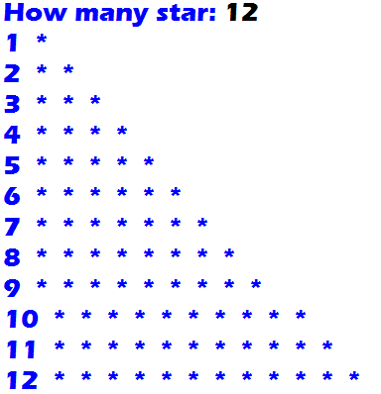
3.
Output

Slide 4
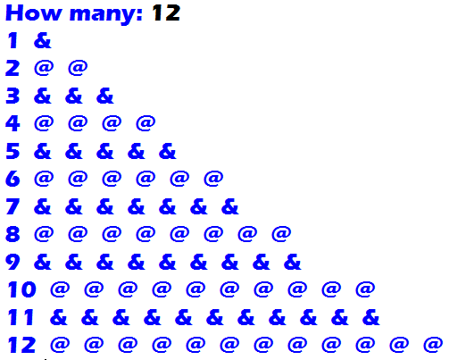
4.
Output

